Slide 1
Animal
Genetics

Slide 2
Objectives
To discover genetics and DNA.
To differentiate between dominant and recessive genes.
To examine the Punnet Square.

Slide 3
Animal
Genetics
Genetic Basics

Slide 4
Gregor Mendel
Is considered the “Father of Modern Genetics”
Pioneered the study of genetics through his early work on the heredity of plants
Traced inheritance patterns and determined they could be described mathematically

Slide 5
Genetics
Is the science of heredity
Accounts for the passing of similar traits from parents to offspring
Involve the processes randomizing inheritance
Create variation in offspring

Slide 6
Genetic Variation
Is necessary for animals to naturally adapt to an environment over time
Improves the genetics of animal populations through proper selection and mating practices
Genetic variation: diversity in a population or species as a result of new gene combinations.

Slide 7
Inheritance
Is the transmission of genes from parents to offspring
Allows an offspring to receive half of their genes from each parent

Slide 8
Animal
Genetics
Structures

Slide 9
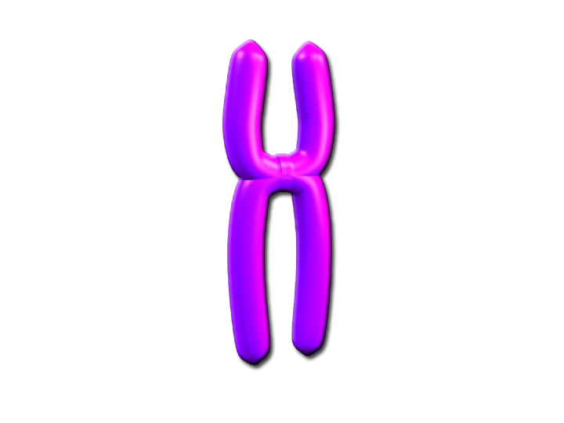
Genetic Material Breakdown
Gene
Chromosome
DNA

Slide 10
Chromosomes
Are composed of continuous strands of DNA
Are located in the cell nucleus
Are found in pairs
known as homologs of each other

Slide 11
Chromosomes
Homolog Pair
Homolog Pair
Loci
Homologs: equal in size and contain similar loci
Loci: location on a chromosome where a gene specifies the code for a trait

Slide 12
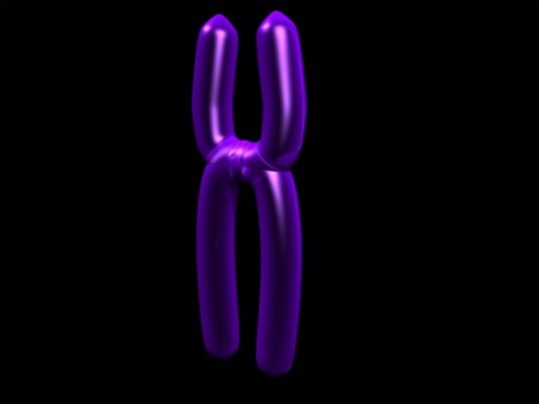
Chromosomes
Attach together by a common centromere
Separate during cell division
Help classify cell type
Centromere: point on a chromosome where homolog pairs are attached.

Slide 13
Cell Division
Is vital for cellular development
Occurs two ways
mitosis
meiosis
Depends on the type of cell
somatic cell
sex cell

Slide 14
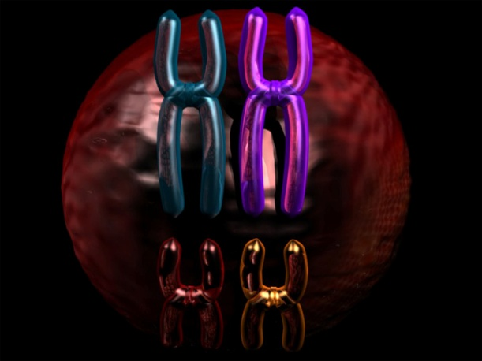
Somatic Cells
Are also known as body cells
liver cells, muscle cells, skin cells
Contain a complete pair of chromosomes
diploid cells
Undergo mitosis
Diploid cells: contain both homologs in a chromosome pair (2n)

Slide 15
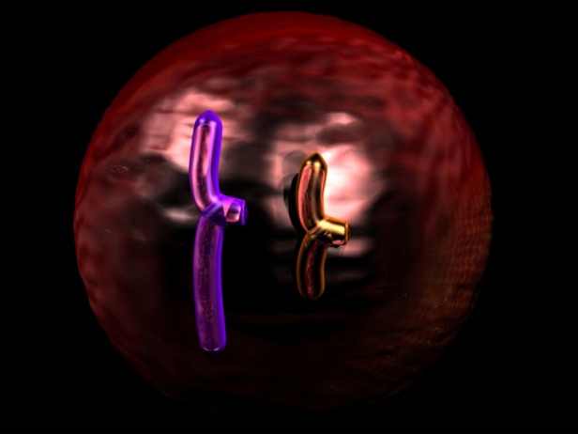
Sex Cells
Also known as gametes
Are located in the sex organs
spermatozoa in male
ova in females

Slide 16
Sex Cells
Contain half of a chromosome pair
haploid cells
Undergo meiosis
Haploid cells: contain only one homolog chromosome (1n)

Slide 17
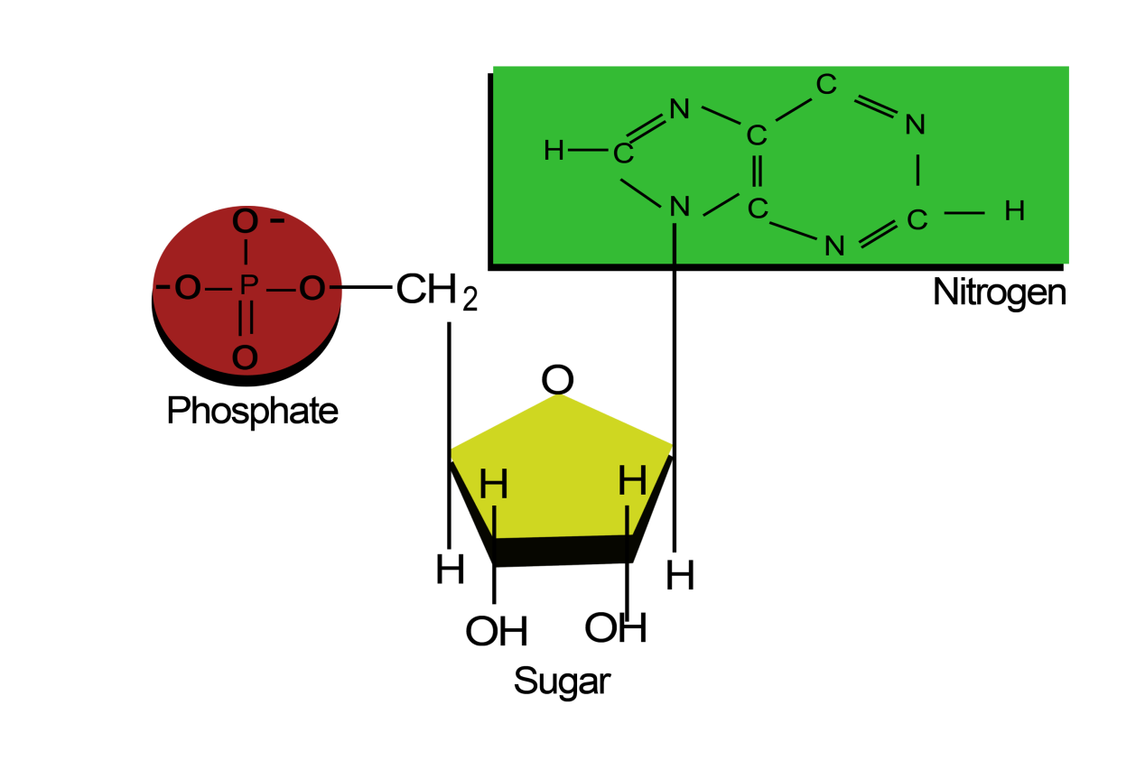
Nucleic Acids
Made from many nucleotides.
three parts
sugar molecule
phosphate molecule
nitrogen base

Slide 18
Nucleic Acids
Sugar molecule
five carbon sugar
Phosphate molecule
Nitrogen base
adenine (A), thymine (T), guanine (G) and cytosine (C)

Slide 19
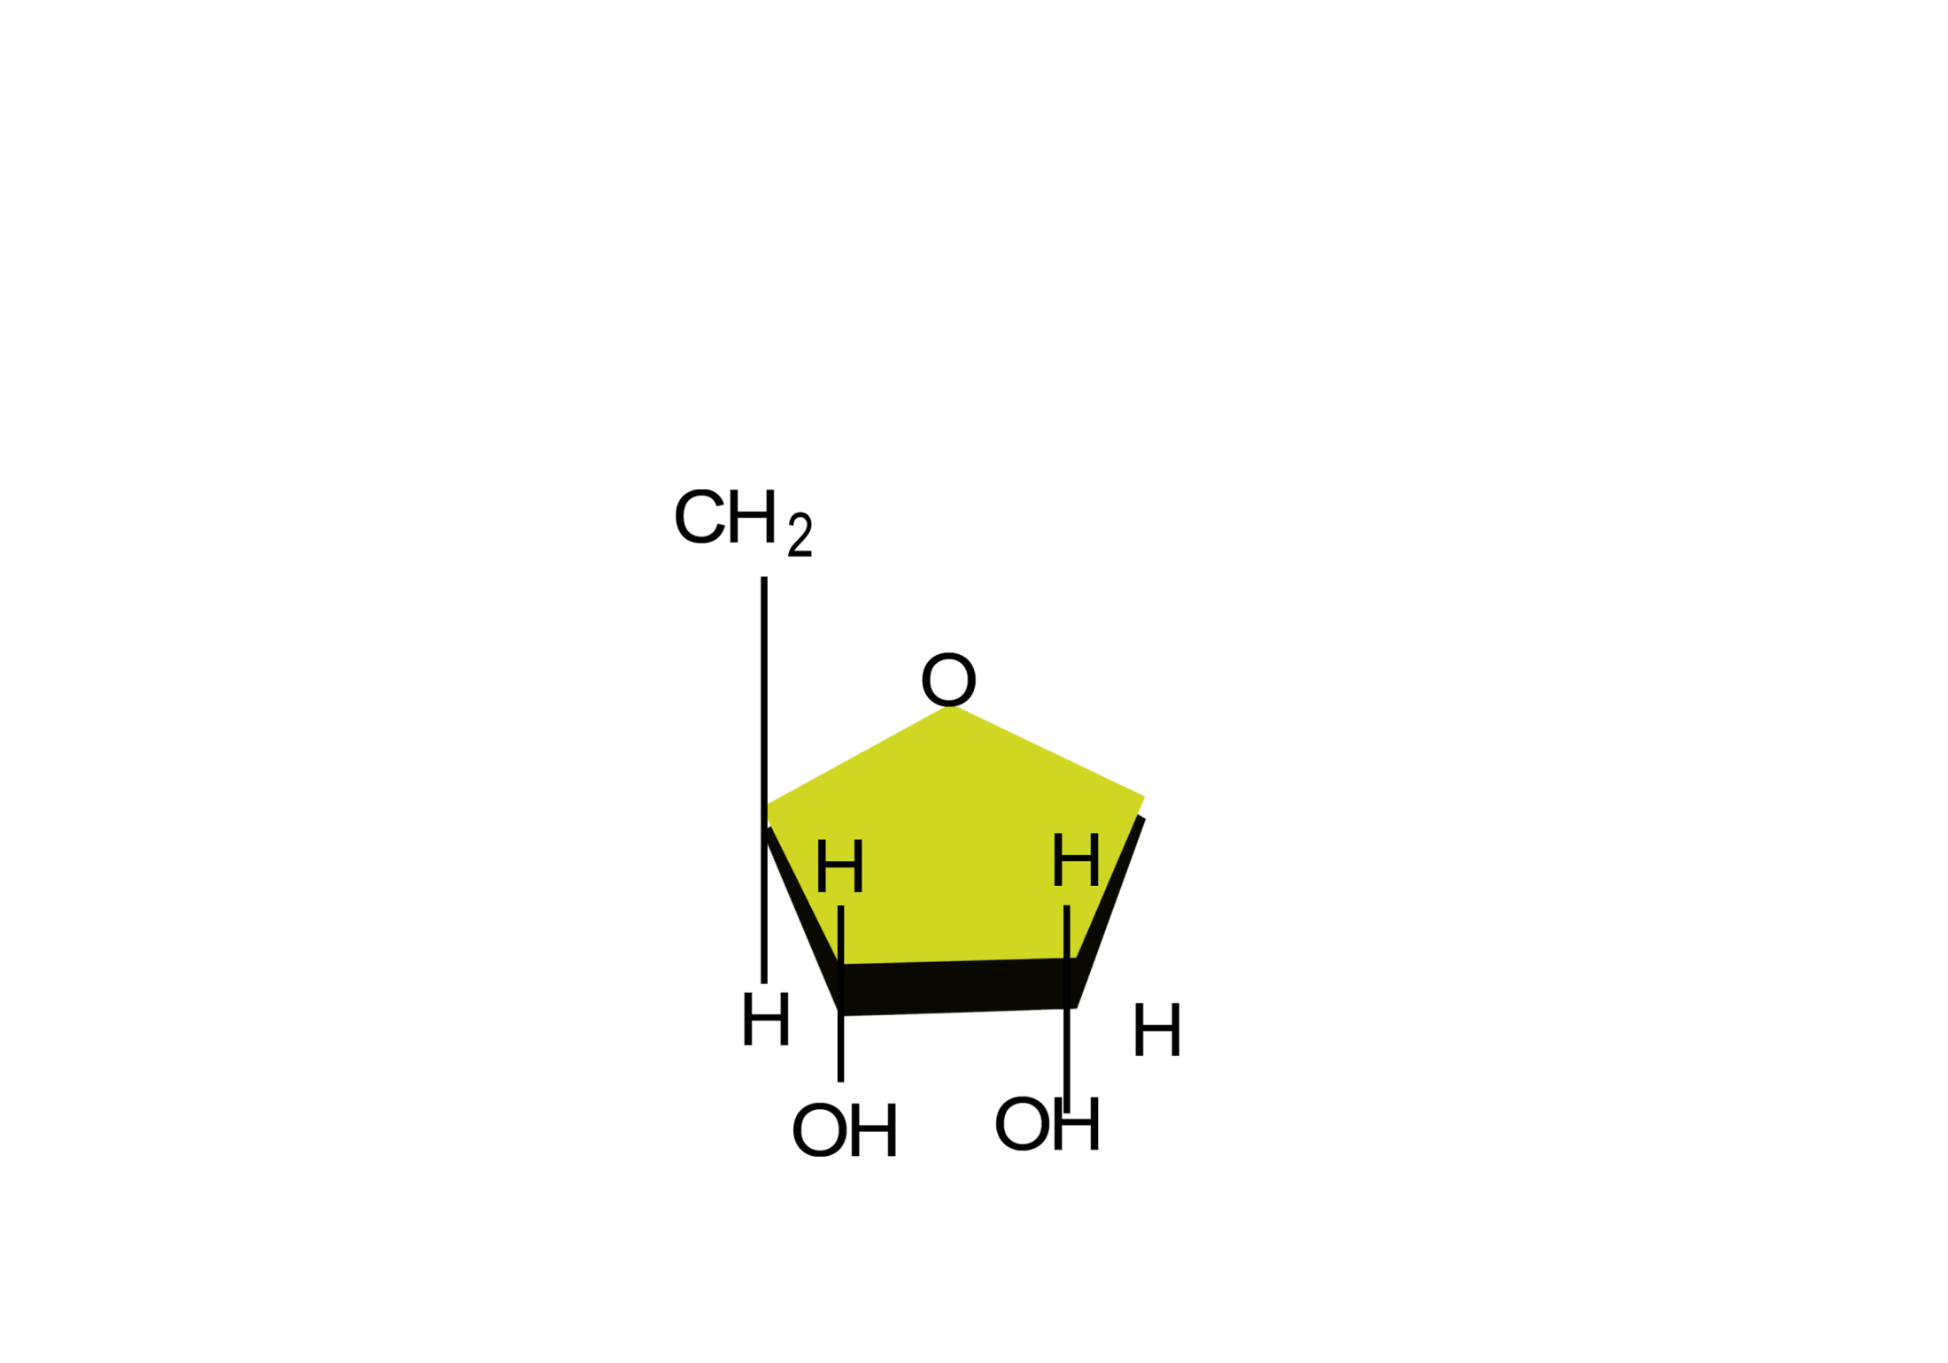
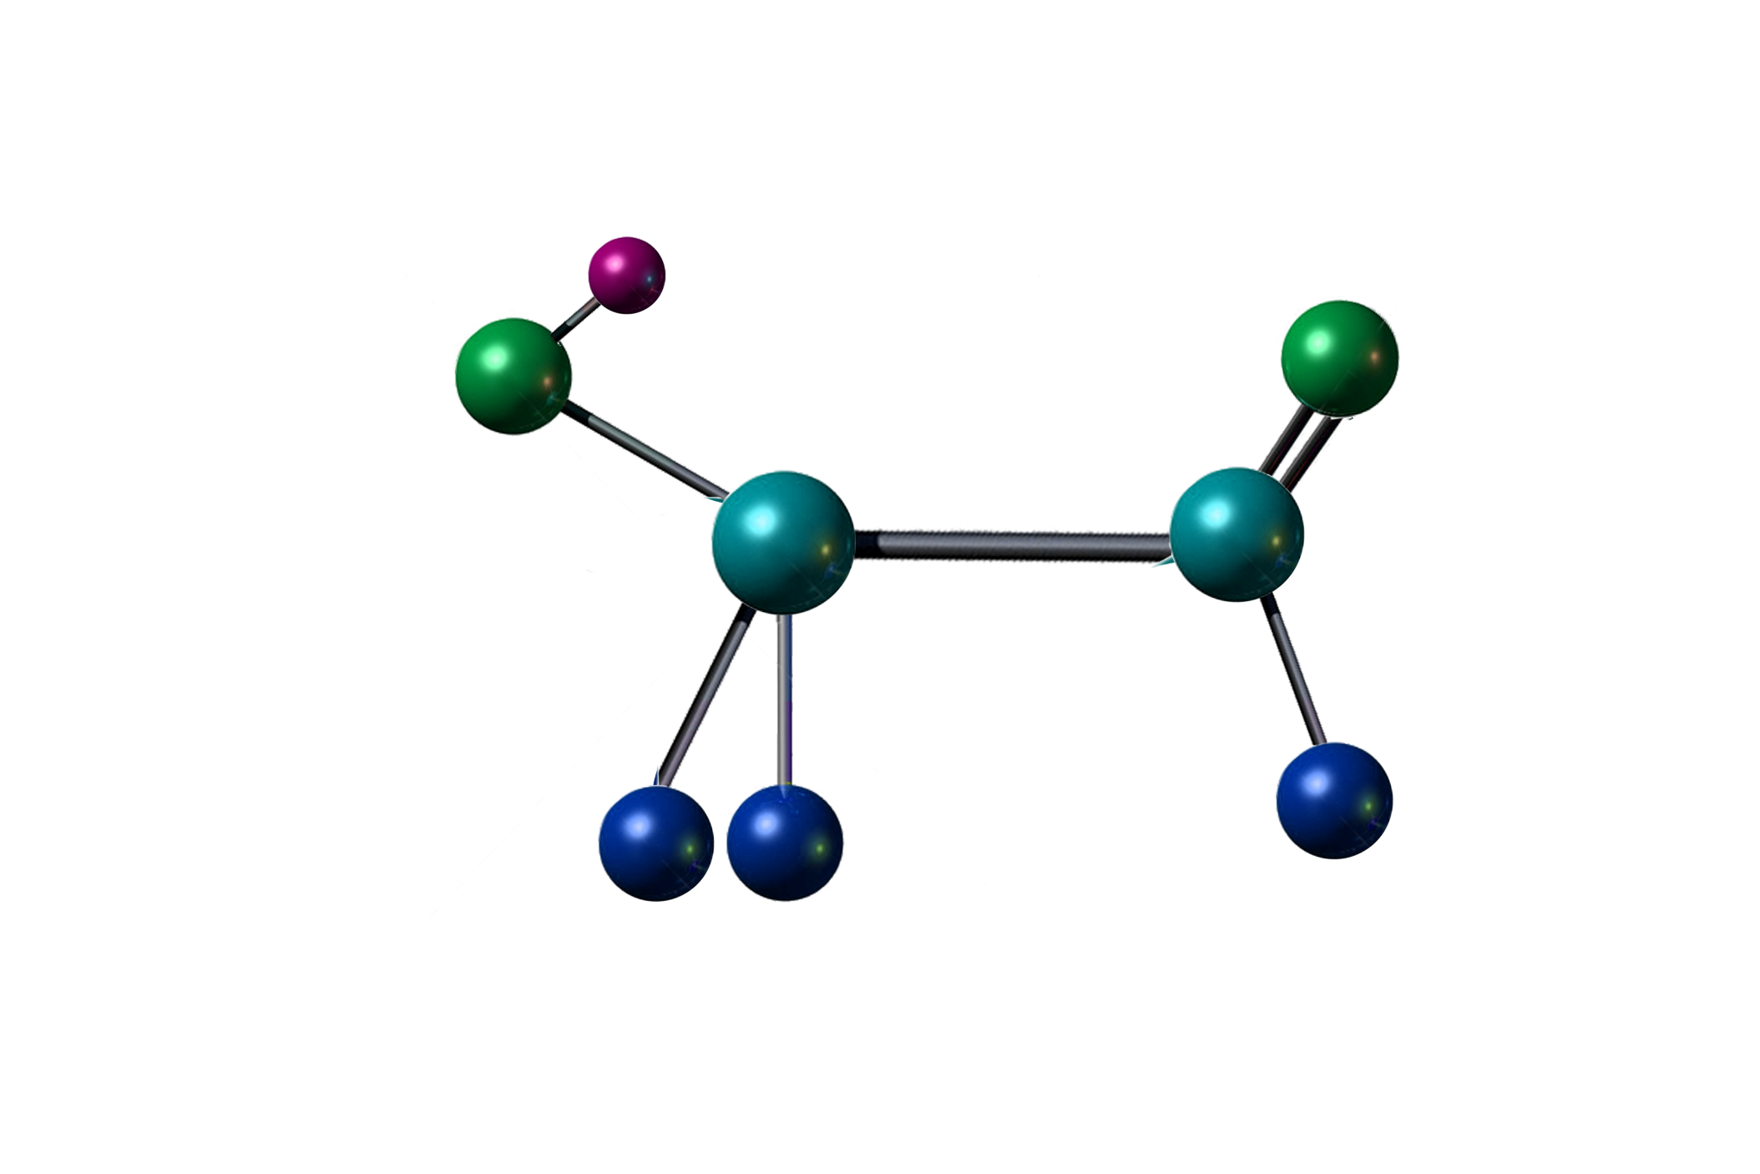
Sugar Molecule

Slide 20
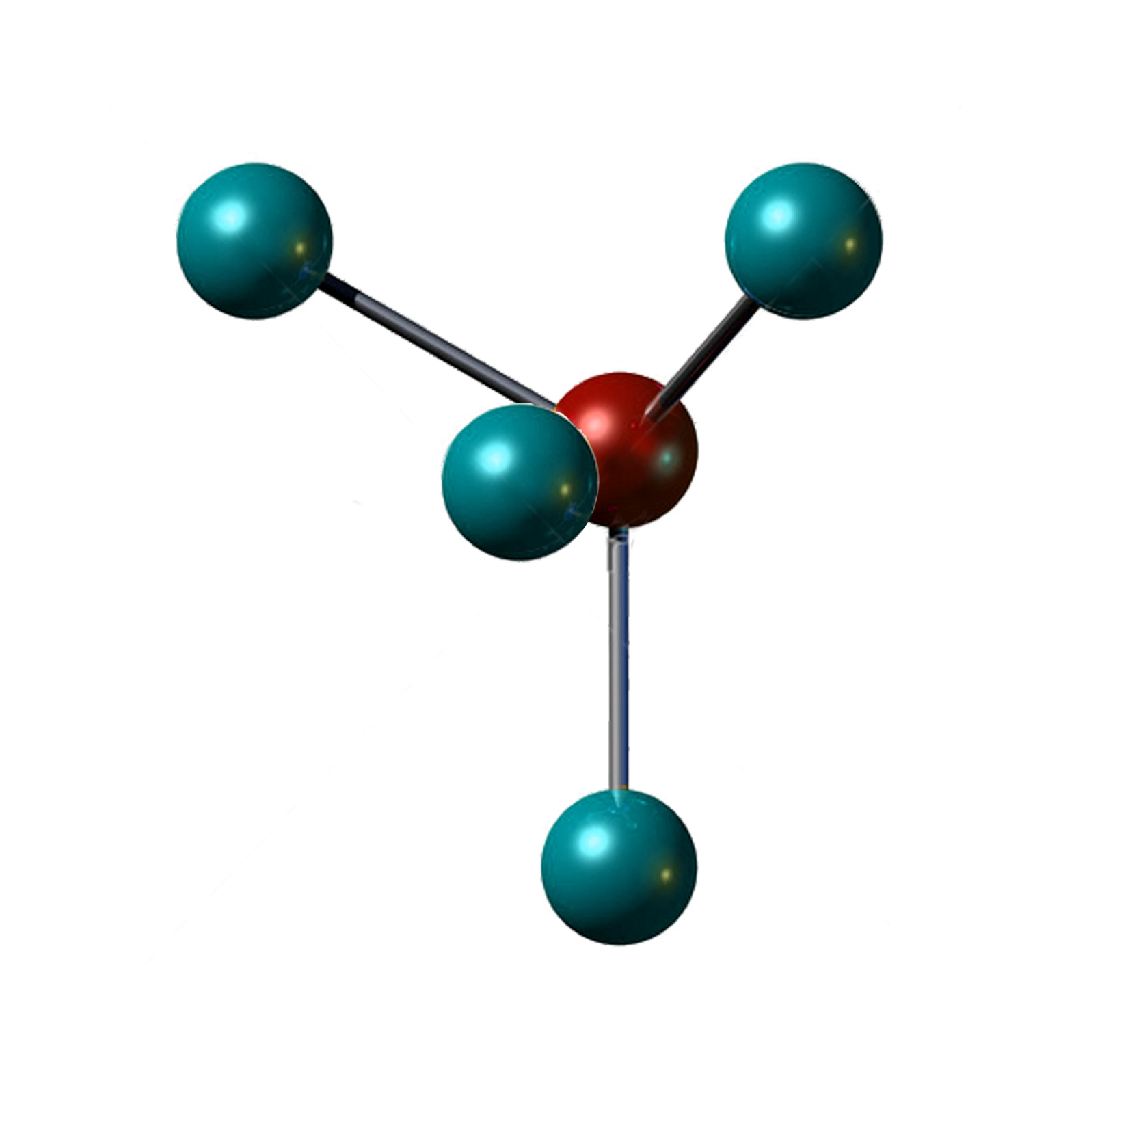
Phosphate Molecule

Slide 21
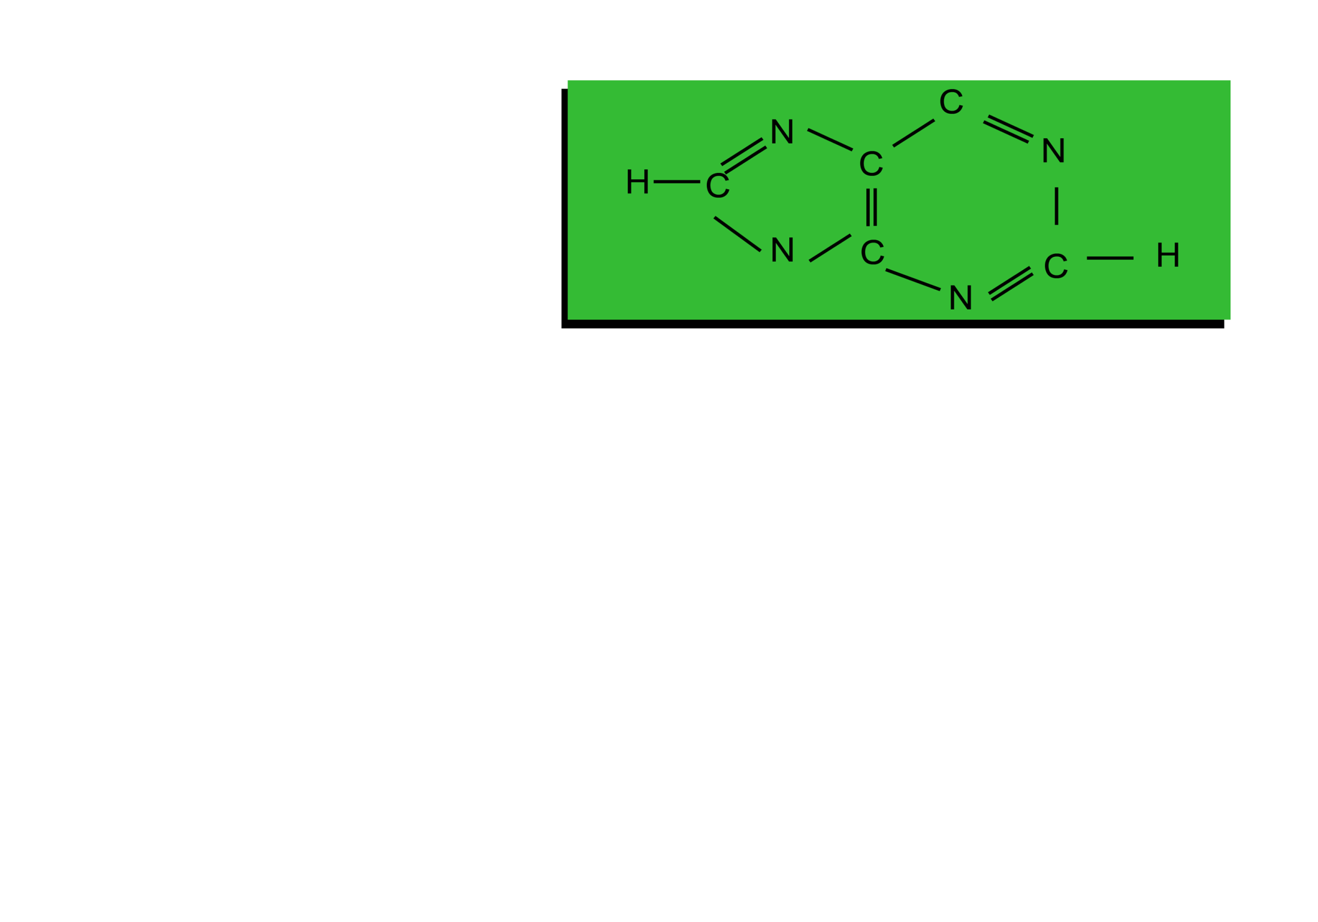
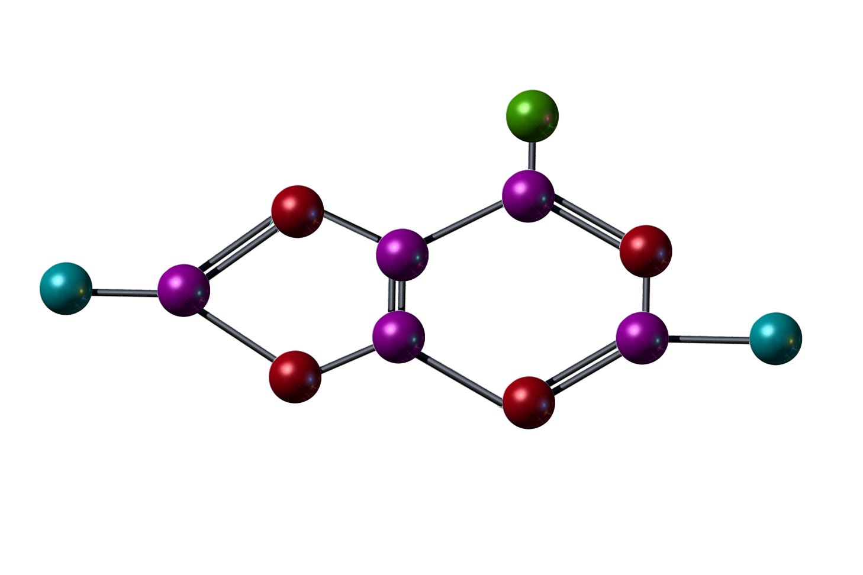
Nitrogen Base

Slide 22
DNA
Is a double stranded helix
Composed of nucleotides
sugar
phosphate group
nitrogenous bases
adenine
thymine
guanine
cytosine
A T
C G

Slide 23
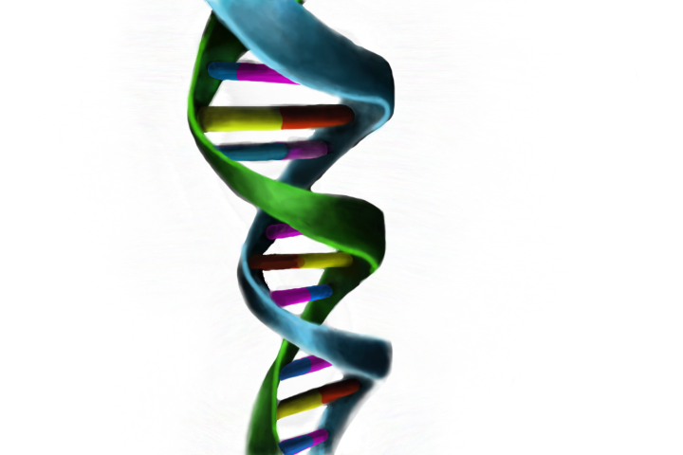
DNA
Stands for deoxyribonucleic acid
Codes genes by a unique sequence
Nitrogenous Bases
Sugar Phosphate Backbone

Slide 24
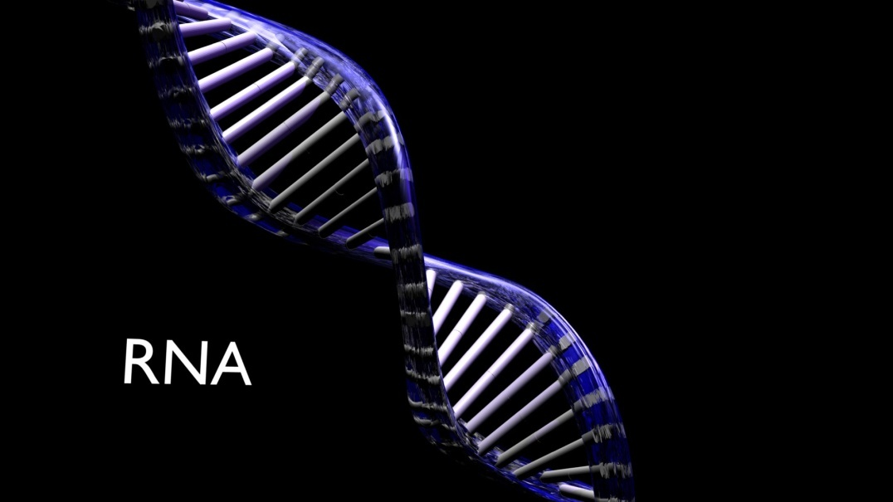
RNA
Ribonucleic acid
Transfers encoded DNA
Single stand
sugar ribose

Slide 25
Genes
Are the basic unit of inheritance
Are a sequence of DNA which codes for a trait
Combine to dictate the physical expression of a trait

Slide 26
Genes
Are housed at different loci (locations) on the chromosome
May contain two or multiple unique alleles at each loci
Note: Genes and alleles are commonly used interchangeably

Slide 27
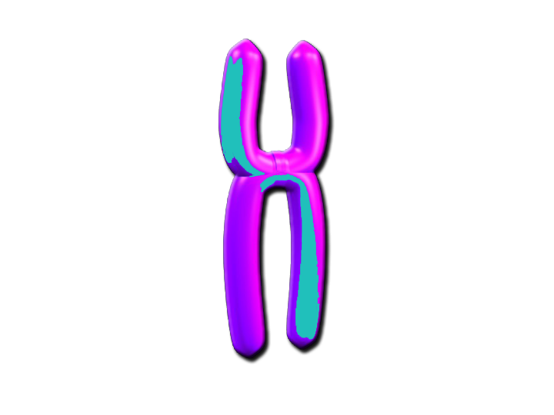
Alleles
Are alternative forms of a gene
Occupy the same loci on paired homolog chromosomes
Control the same inherited characteristic or trait
Allele
Allele

Slide 28
Alleles
Combine to determine an animals’ genotype
Can be dominant or recessive
Genotype: combination of genes present at the same locus

Slide 29
Dominant Alleles
Mask the physical expression of recessive alleles
Usually determine the phenotype of an animal

Slide 30
Dominant Alleles
Are represented with a capital letter
Example:
BB or Bb
Phenotype: physical characteristics of an animal

Slide 31
Recessive Alleles
Yield to the expression of the dominant gene
Are represented with a lower case letter
Example:
bb

Slide 32
Animal
Genetics
Genetic & Physical Expression

Slide 33
Genotype vs. Phenotype
Genotype
genetic combination between genes at a certain loci
Phenotype
physical characteristic an animal expresses due to its genotype and environment
Note: Environmental refers to all non-genetic factors.

Slide 34
Scenario
Two kittens are identical twins, thus having the same genetic makeup
One is given to a home where it will live indoors
The other is given to a home where it will live outdoors

Slide 35
Scenario
Do you think these cats will look the same when they are one year old?
Consider physical characteristics
coat
thickness
shine
weight/size

Slide 36
Scenario
Discuss environmental factors affecting the physical condition of the two cats
self-feeder vs. hunting for food
central heat vs. coping with changing climate
no outside threats vs. surviving dogs and cars

Slide 37
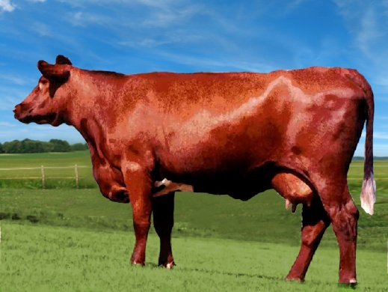
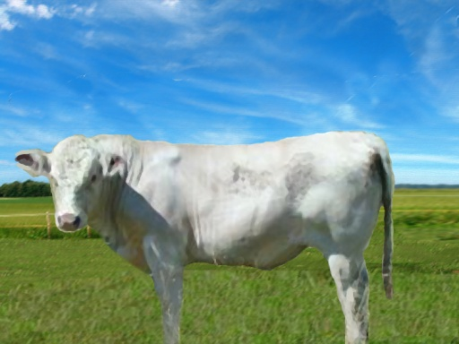
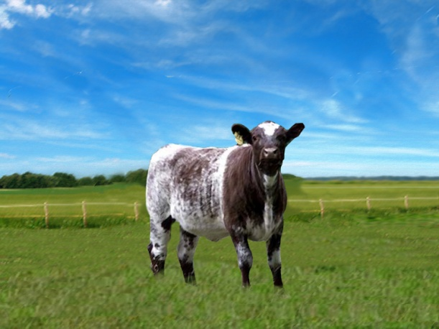
Partial Dominance
Occurs when the phenotype of the offspring is intermediate to the phenotype of the parents
Example:
roan coat color

Slide 38
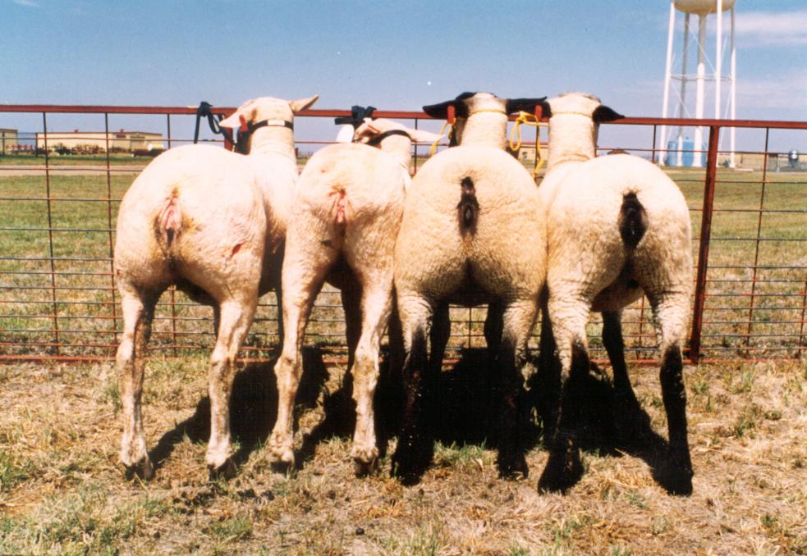
Overdominance
Occurs when a heterozygote animal expresses a phenotype outside the range of the homozygote phenotype
Example:
Callipyge in sheep
extreme muscle growth
Source: Samuel P. Jackson, Ph.D. Texas Tech University

Slide 39
Homozygous vs. Heterozygous
Homozygous genotype
are composed of two copies of identical genes
example:
bb or BB

Slide 40
Homozygous vs. Heterozygous
Heterozygous genotype
are composed of two genes which are different
example:
Bb

Slide 41
Example
Every dog has an extension locus coding for coat color
There are two possible alleles at this locus
black
chocolate
The black allele is dominate
The chocolate allele is recessive

Slide 42
Example
If both genes are black (BB) or one is black and one is brown (Bb), the dog is black
If both genes are brown at the locus (bb), the dog is brown

Slide 43
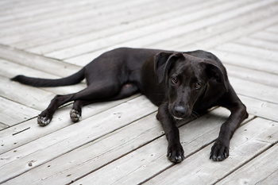
Example
Since black is dominate both the and heterozygous and homozygous black genes will physically express a black coat color
Heterozygous (Bb) =
Homozygous (BB) =

Slide 44
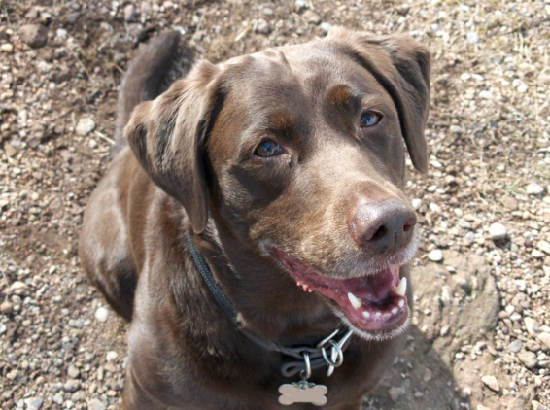
Example
Since brown is recessive, the gene must be homozygous in order for the dog to physically express a brown coat color
Homozygous (bb) =

Slide 45
Animal
Genetics
The Punnet Square

Slide 46
Punnet Squares
Are used to determine the probability of a particular genotype in an offspring
Are made by crossing the genes of the mother and father

Slide 47
Punnet Square
Maternal Genotype
Maternal
Gene 1
Maternal
Gene 2
Paternal Genotype
Paternal
Gene 1
Combination
Of M1 and P1
Combination
Of M2 and P1
Paternal
Gene 2
Combination
Of M1 and P2
Combination
Of M2 and P2

Slide 48
Punnet Square Example
You own a black heterozygous bull and a black heterozygous cow. Each of their genotypes for color is Bb. You decide to breed the cattle.
Predict the percentage of offspring with a black coat by drawing a Punnet Square.

Slide 49
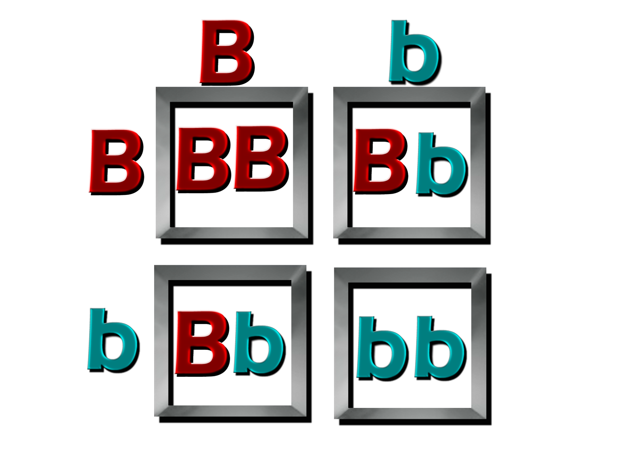
Punnet Square Example
Maternal Genotype
Paternal Genotype

Slide 50
Offspring Outcomes
25 percent
genotype: homozygous dominant (BB)
phenotype: black
25 percent
genotype: homozygous recessive (bb)
phenotype: red

Slide 51
Offspring Outcomes
50 percent
genotype: heterozygous dominant (Bb) black
phenotype: black

Slide 52
Animal
Genetics
Heritability

Slide 53
Heritability
Measures the degree to which offspring resemble their parents for a particular trait
Allows producers to improve genetic selection practices
Is generally represented by h2

Slide 54
Heritability
Varies depending on what controls and affects certain traits
genetics
environment
Highly heritable traits are mainly controlled by genetics
mature height
carcass characteristics
wool production

Slide 55
Heritability
Lowly heritable traits are affected primarily by the environment
reproductive traits
survivability

Slide 56
Hybrid Vigor
Is also known as heterosis
Occurs when two unrelated animals breed (crossbreeding)
Increases the number of heterozygous dominate genotypes

Slide 57
Hybrid Vigor
Ensures a greater proportion of homologs having at least one dominate allele at every locus
Helps produce a greater likelihood of favorable traits in a herd

Slide 58
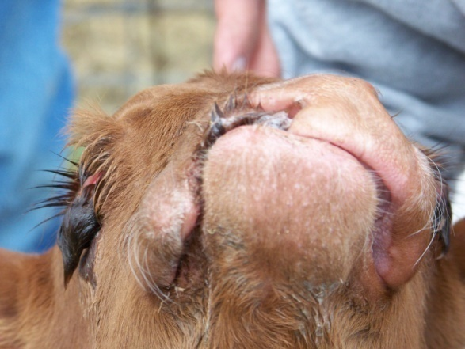
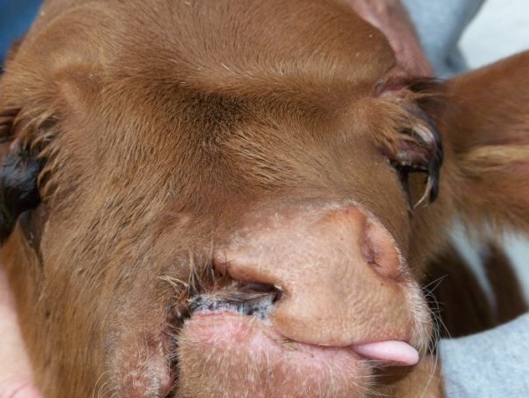
Genetic Mutations
Occur during DNA replication
Are alterations in the genetic material
Create variation in an animal gene pool
Can be helpful or extremely harmful

Slide 59
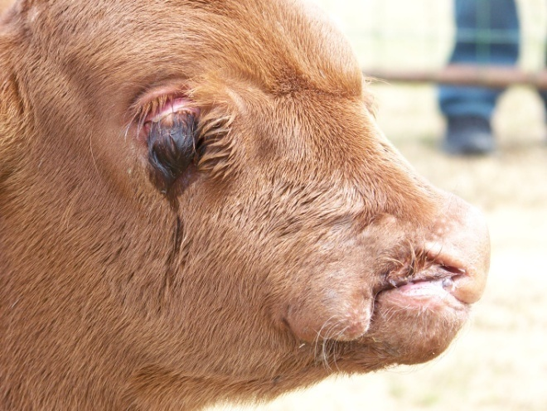
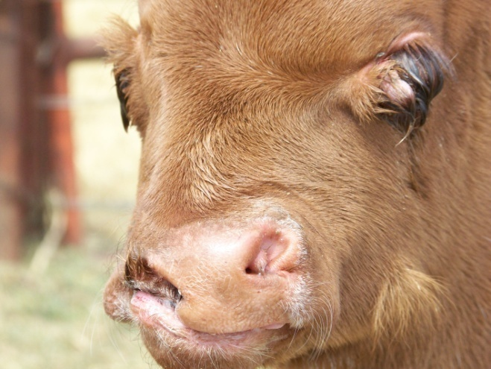
Genetic Mutations
Can be caused by:
mutagenic chemicals
UV radiation
errors in DNA copying
viruses

Slide 60
Animal
Genetics
Research
& Technology

Slide 61
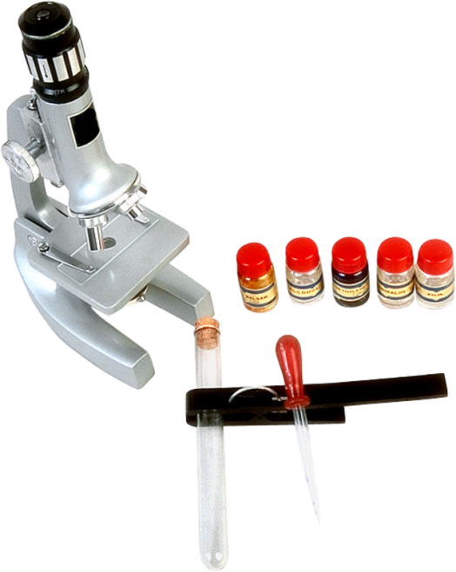
Medical Genetics Research
Is completed to study the genetic causes of diseases
Searches for unknown genes which may cause a disease

Slide 62
Genetic Research
Restriction enzymes
cut DNA at specific sequences in order to re-link the DNA to create recombinant DNA
Recombinant DNA
is found in genetically modified organisms

Slide 63
Genetic Research
DNA sequencing
allows researchers to determine the sequence of nucleotides in DNA segments
is a vital part of genome assembly

Slide 64
Genetic Technology
Genomics
uses computational tools to analyze patterns in the full genomes of organisms
allowed for the human genome to be mapped

Slide 65
Resources
Campbell, N.A., Reece, J.B, Mitchell, L.G., & Taylor, M.R. (2003). Biology Concepts & Connections 4th edition. San Francisco, CA: Benjamin Cummings
www.genetics.org

Slide 66
Acknowledgements
Project Coordinator:
Meghan Blanek
Collaborator:
Ryan Rathmann, Ph.D.
Production Coordinator:
Megan Mitchell
Amber Krause
Production Manager:
Dusty Moore
Graphic Designer:
Ann Adams
Melody Rowell
Daniel Johnson
Executive Producers:
Gordon Davis, Ph.D.,
Jeff Lansdell
© MMIX
CEV Multimedia, Ltd.

